Slide 1

माधव प्रौद्योगिकी एवं विज्ञान संस्थान, ग्वालियर (म.प्र.), भारत
MADHAV INSTITUTE OF TECHNOLOGY & SCIENCE, GWALIOR (M.P.), INDIA
Deemed to be University
(Declared under Distinct Category by Ministry of Education, Government of India)
NAAC ACCREDITED WITH A++ GRADE
DEPARTMENT OF ENGINEERING MATHEMATICS AND COMPUTING
CREATIVE PROBLEM SOLVING (250705)
PROJECT PRESENTATION
Presented By:
0901MC211004 Abhishek Patel
0901MC211022 Chirag Gupta
0901MC211026 Divyansh Savita
0901MC211058 Shaily Singh
0901MC211061 Sonali Patel
Presented To:
Dr. S.K. Bhardwaj
Assistant Professor
Department of Mathematics And Computing

Slide 2

Image classification Fashion-Mnist

Slide 3
INTRODUCTION
Fashion-MNIST classification using Convolutional Neural Networks (CNNs) is a machine learning project designed to classify images of clothing and accessories into predefined categories. The project utilizes the Fashion-MNIST dataset, which comprises 70,000 grayscale images of 28x28 pixels, divided into 10 categories such as T-shirts, dresses, sneakers, and bags. This dataset serves as a modern benchmark for image classification tasks, offering a more challenging alternative to the traditional MNIST handwritten digits dataset.
In this project, CNNs are employed due to their ability to automatically learn hierarchical features from image data. These networks mimic the way the human brain processes visual information by using convolutional layers to detect patterns, pooling layers to reduce dimensionality, and dense layers to perform classification. The model is trained on 60,000 images and evaluated on 10,000 test images to assess its accuracy and generalization.
The project involves several steps, including data preprocessing, model building, training, evaluation, and visualization of results. Techniques such as feature scaling and data splitting are applied to ensure the model's robustness. By leveraging CNNs, the project demonstrates the power of deep learning in handling complex image classification tasks, paving the way for applications in fields such as fashion technology, e-commerce, and image recognition systems.

Slide 4
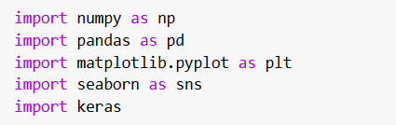
Importing Libraries
Numpy: For numerical operations and data manipulation.
Matplotlib.pyplot: For visualizing images and results.
Seaborn: For creating heatmaps (used later for the confusion matrix).
Keras: To build and train neural networks.

Slide 5
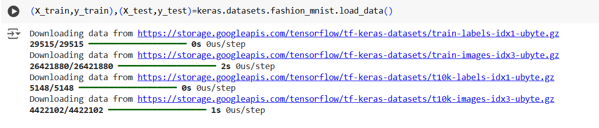
Data Preprocessing
1. Load Dataset
The Fashion-MNIST dataset is available in Keras and consists of 60,000 training images and 10,000 test images of size 28x28 pixels, with 10 classes of clothing items (e.g., t-shirts, trousers, dresses, etc.).
X_train and X_test contain the images in the form of numpy arrays with shape (60000, 28, 28) and (10000, 28, 28) respectively.
y_train and y_test contain the class labels for the images.

Slide 6

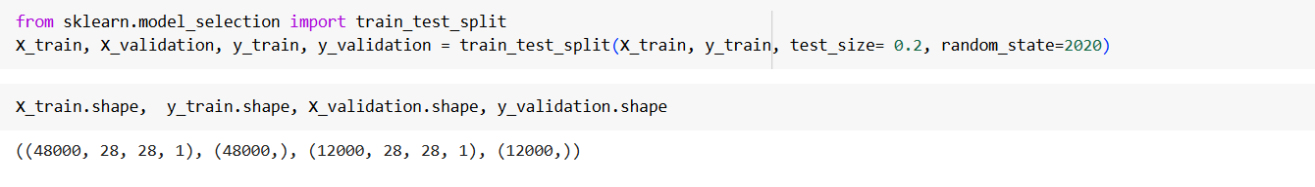
2. Normalization/Feature Scaling
Normalization is essential to ensure that all pixel values fall within a similar range, typically between 0 and 1. This helps in faster convergence when training a neural network. Since pixel values range from 0 to 255, we divide by 255 to scale them to [0, 1].
3. Splitting Data into Training and Validation Sets
split the training data further into training and validation sets. This helps to evaluate the model performance during training.

Slide 7
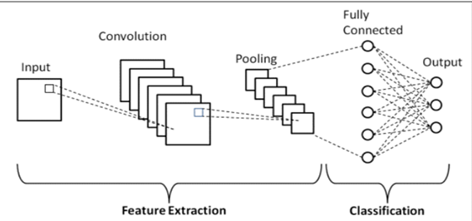

Building the First CNN
For building an image classifier here we use deep convolutional neural networks (CNN’s). So, let’s see what happens in each step in a CNN.
Layers in a CNN:
Convolution Layer
Pooling Layer
Fully Connected Layer/Dense Layer
We are going to build a sequential model. The sequential model is a linear stack of layers and this is how we build a sequential model in python.
Once the sequential model is defined then we can add different layers required as explained below.

Slide 8
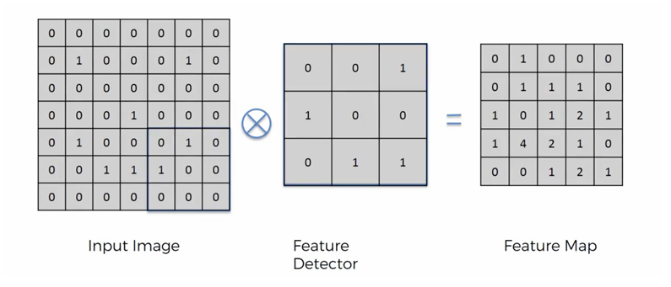
Convolution Layer:
The primary purpose of Convolution in case of a CNN is to extract features from the input image. Convolution preserves the spatial relationship between pixels by learning image features using small squares of input data.
Every image can be considered as a matrix of pixel values. Consider a 7 x 7 image whose pixel values are only 0 and 1 (note that for a grayscale image, pixel values range from 0 to 255, the input matrix below is a special case where pixel values are only 0 and 1). Also, consider another 3 x 3 matrix as shown below. Then, the Convolution of the 7 x 7 image and the 3 x 3 matrix can be computed as shown.

Slide 9
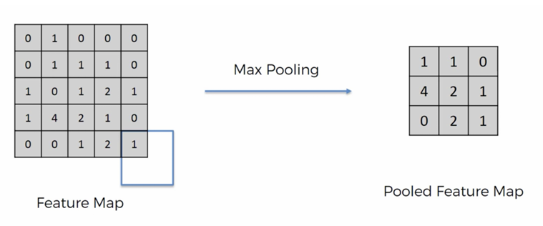
Pooling Layer:
Pooling reduces the dimensionality of each feature map but retains the most important information. Spatial Pooling can be of different types: Max, Average, Sum etc. In case of Max Pooling, we define a spatial neighborhood (a 2×2 window which we considered in this project) and take the largest element from the rectified feature map within that window.
Fully Connected Layer/Dense Layer:
The term “Fully Connected” implies that every neuron in the previous layer is connected to every neuron on the next layer. The output from the convolutional and pooling layers represent high level features of the input image. The purpose of the Fully Connected layer is to use these features for classifying the input image into various classes based on the training dataset. Fully connected layer uses a ‘softmax’ activation function in the output layer.

Slide 10
Now let’s understands how the computation happened above. We slide the 3 x 3 matrix over our original image (7 x 7) by 1 pixel (also called ‘stride’) and for every position, we compute element wise multiplication (between the two matrices) and add the multiplication outputs to get the final integer which forms a single element of the output matrix (Feature Map). Note that the 3×3 matrix “sees” only a part of the input image in each stride. In CNN terminology, the 3×3 matrix is called a ‘filter’ or ‘kernel’ or ‘feature detector’ and the matrix formed by sliding the filter over the image and computing the dot product is called the ‘Convolved Feature’ or ‘Activation Map’ or the ‘Feature Map’. It is important to note that filters act as feature detectors from the original input image.
The size of the Feature Map is controlled by three parameters:
Depth: Depth corresponds to the number of filters we use for the convolution operation.
Stride: Stride is the number of pixels by which we slide our filter matrix over the input matrix.
Padding: Sometimes, it is convenient to pad the input matrix with zeros around the border, so that we can apply the filter to bordering elements of our input image matrix.
Introducing Non-Linearity (ReLU):
ReLU is an element wise operation (applied per pixel) and replaces all negative pixel values in the feature map by zero. The purpose of ReLu is to introduce non-linearity in CNN.

Slide 11
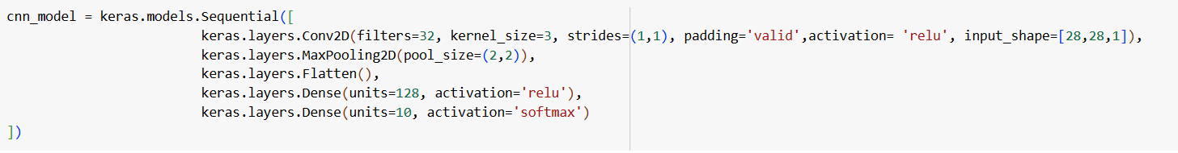
Flattening:
Flattening is the process of converting all the resultant 2 dimensional arrays into a single long continuous linear vector.
SoftMax:
The SoftMax activation function is useful predominantly in the output layer of a clustering system. Softmax functions convert a raw value into a posterior probability. The sum of output probabilities from the Fully Connected Layer is always 1. This provides a measure of certainty.

Slide 12
Compiling the Model:
Adam:
Adam stands for Adaptive Moment Estimation. The core idea behind Adam is to compute adaptive learning rates for each parameter in the model. Unlike traditional gradient descent, which uses a fixed learning rate, Adam adjusts the learning rate dynamically for each parameter based on the history of its gradients. This means that parameters with larger gradients get smaller updates, and parameters with smaller gradients receive larger updates, allowing the optimizer to focus on parameters that are more important for learning.
Categorical Cross-Entropy:
Cross-entropy loss, or log loss, measures the performance of a classification model whose output is a probability value between 0 and 1. Cross-entropy loss increases as the predicted probability diverges from the actual label.
Evaluation Metric:
Evaluation metrics explain the performance of a model. An important aspects of evaluation metrics is their capability to discriminate among model results. Because we have equal number of samples from each class initially we are using ‘Accuracy’ to evaluate the performance of the model. Also, we will plot confusion matrix and observe different metrics in our later analysis.

Slide 13
Training the Model:
We use fit method to train our model. Also, we will be optimizing the weights to improve model efficiency and now the question is when are we optimizing the weights? Hence, we use batch-size to specify the number of observations after which we want to update the weights. Epoch is nothing but the total number of iterations. There is no specific rule or method to choose batch-size and epoch values. It’s a trial and error, we had experimented different values and finally stick to use the below mentioned values.
Let’s see how we fit our model in python:

Slide 14
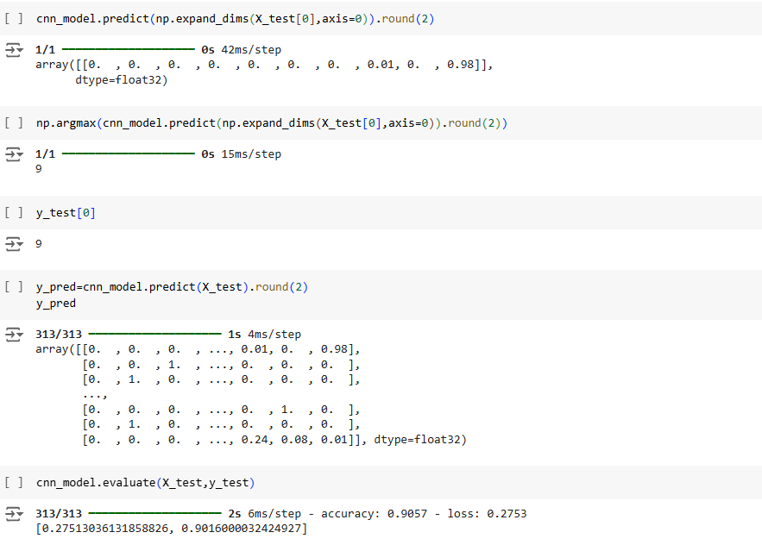
Testing and Evaluating the Model

Slide 15
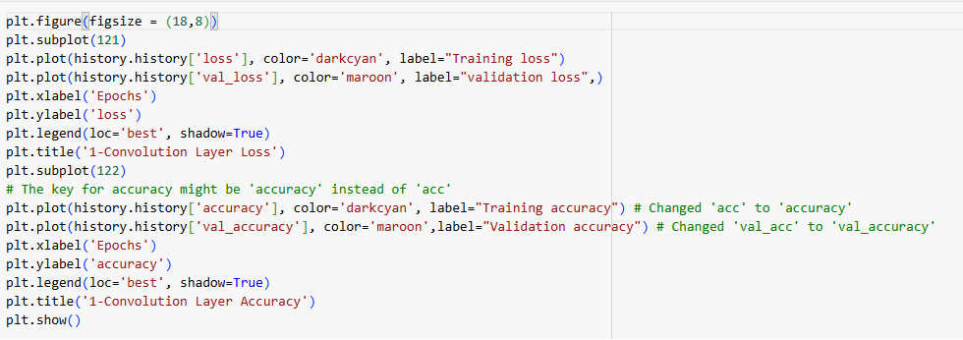
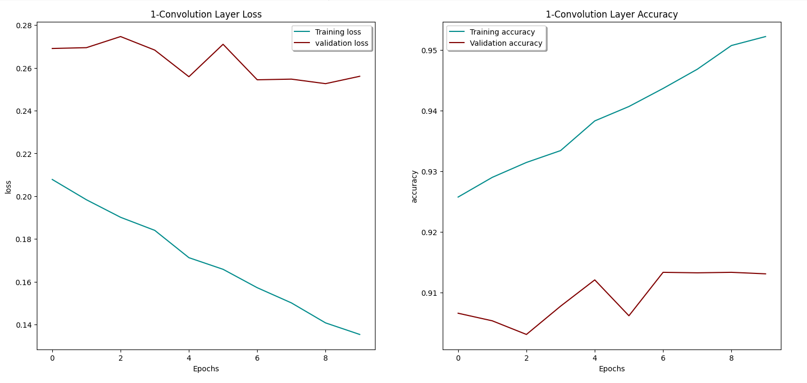

Slide 16
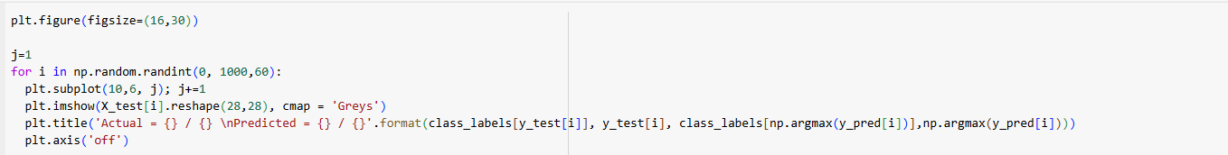
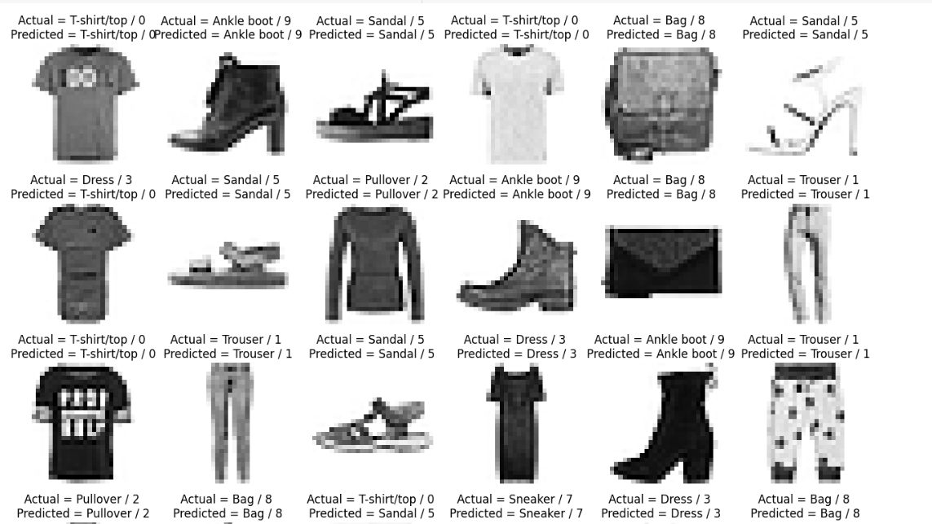
VISUALIZE OUTPUT
Displays predictions alongside actual images for comparison.

Slide 17
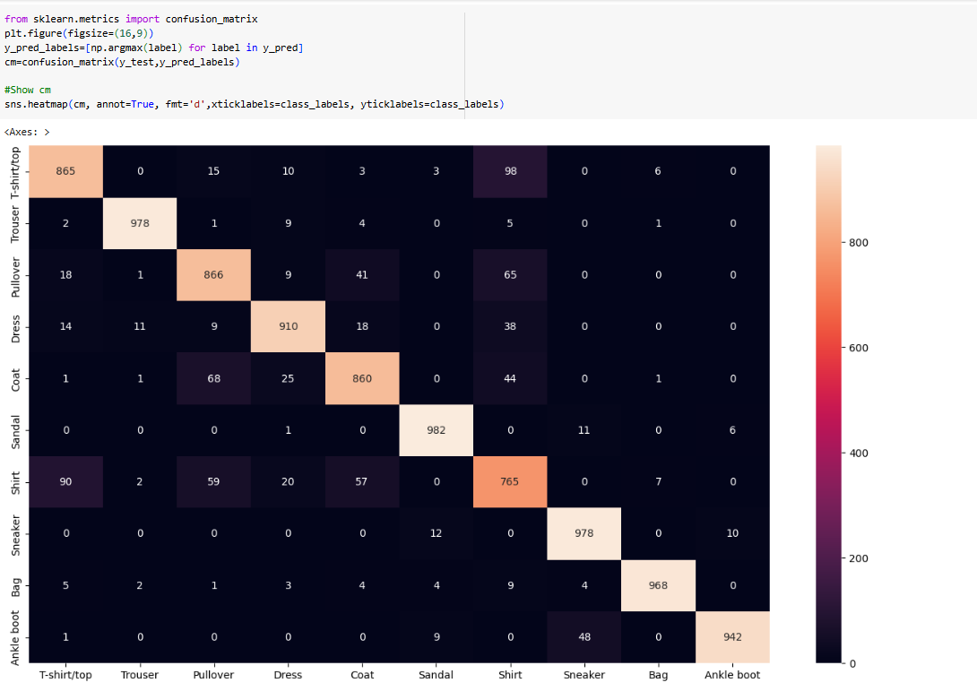
CONFUSION MATRIX
Confusion Matrix helps us to describe the performance of the classifier visually by plotting the true labels and predicted labels.

Slide 18
Classification report
The classification report provides a detailed evaluation of the performance of a classification model. It computes key metrics for each class and offers insights into precision, recall, and F1-score.For the Fashion-MNIST dataset, where we classify images into 10 categories, the classification report evaluates the CNN model's performance on these categories.
High-performing Classes:
Trouser (1), Sandal (5), and Ankle boot (9) have high precision, recall, and F1-scores, indicating the model predicts these classes accurately.
Challenging Classes:
Shirt (6) has lower scores, particularly in precision and recall. This could be due to its similarity to other classes like T-shirt/top (0) and Pullover (2).
Overall Model Performance:
Averaged metrics across all classes provide an indication of the model's general effectiveness:
Macro Average: Unweighted mean across all classes (treats all classes equally).
Weighted Average: Mean weighted by the number of true instances in each class (accounts for class imbalance).

Slide 19
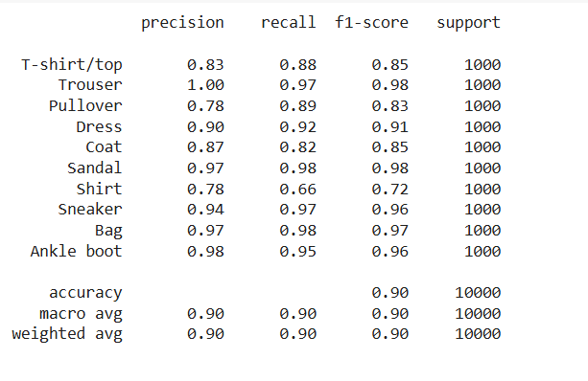

Slide 20
IMPROVE MODEL ACCURACY
Hyperparameter Tuning
Usetools like GridSearchCV, RandomSearch, or Optuna for automated hyperparameter optimization.
Key parameters to tune:
Number of filters in Conv2D layers
Kernel size
Dropout rate
Learning rate
Batch size
Data Augmentation:
Deep networks need large amount of training data to achieve good performance. To build a powerful image classifier using very little training data, image augmentation is usually required to boost the performance of deep networks. Image augmentation artificially creates training images through different ways of processing or combination of multiple processing, such as random rotation, shifts, shear, zoom and flips, etc.

Slide 21
THANK YOU!

